Slide 1


HEALTH MONITORING DEVICE USING ARDUINO

Slide 2
Outline
Introduction
Objective
Components required
Procedure
Design flow
Applications
Drawbacks

Slide 3
Introduction
With advancements in Technology and people being more conscious about their health than ever, technical advancements in the field of medicine are inevitable. People are switching towards devices their health related data . This project looks into the development of a heart rate monitor to keep track of the user’s heart rate. The report presents the development of a heart rate monitor The heart rate monitor developed uses the photoplethysmography (PPG) principle to calculate the heart beats per minute.
The PPG module developed is then interfaced with an Arduino Uno board responsible for calculating the beats per minute. It then displays the serial data in the serial plotter .The results show that the heart rate is successfully transferred and could be helpful in emergency or monitoring situations.

Slide 4
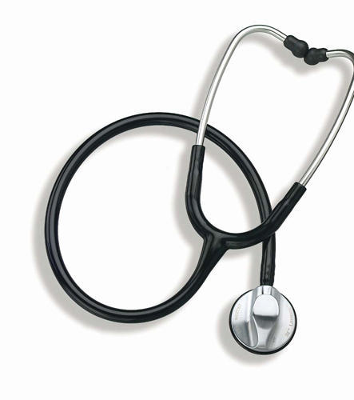
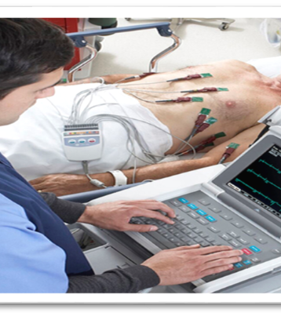
Measurements of Heart Rate
Stethoscope
-is inaccurate.
- is also a prediction based
system.
Electrocardiogram
-Costly
-Not user Friendly

Slide 5

Why Microcontroller Arduino UNO and not Microprocessor?
Single chip
RAM
ROM
i/o Ports
Easy to code(as designed for specific task only)
Low costs

Slide 6

Objective
Analysis of Heartbeat Signals for increasing accuracy of BPM.
To design and fabricate patient monitoring system for monitoring Heart rate signal.
USING THE BUILT IN SERIAL MONITOR TO DISPLAY THE DATA

Slide 7
Proposed System
We proposed a heartbeat monitoring system which receives the signal from the Heartbeat Sensor and Calculate the heart-beat’s per minute(BPM) on Arduino Uno device and it display’s it on serial plotter

Slide 8
REQUIREMENTS
Hardware Requirements :
1. Arduino uno
2. Heart beat sensor.
3. Jumper wires
4. USB cable
Software Requirements :
1.Arduino IDE

Slide 9
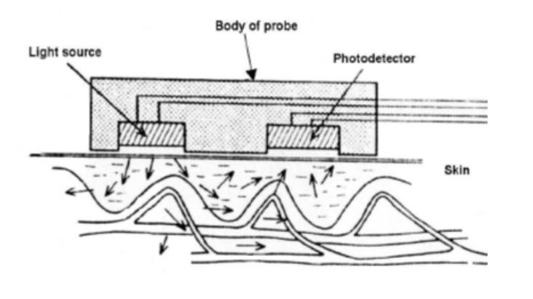
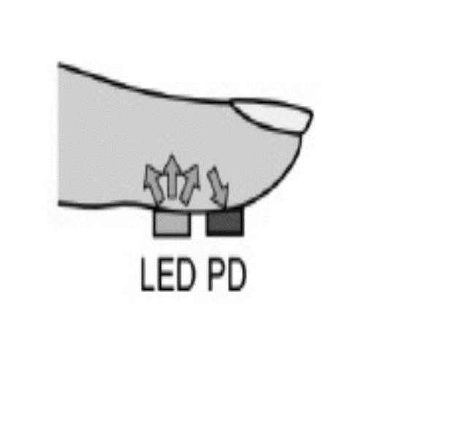
Photoplethysmography:-
Photoplethysmography is a derivative of plethysmography technique, where in a simple
optical setup can help detect volume changes in peripheral blood circulation.
John Allen describes this technique as a non-invasive method since it makes measurements at the skin surface.
The technology uses optoelectronic components, such as a red or near infrared light
source, to illuminate skin and a photodetector to observe the variations in light intensity within the observed area.
Usually, a red or near infrared source of light is used to illuminate skin. This
light then travels through tissues and is absorbed by pigments, bones, and blood. The PPG sensors optically observe changes in blood flow volume by detecting changes in light intensity.

Slide 10
Arduino UNO Board
Arduino Uno is a microcontroller board based on the ATmega328P (datasheet).
It has 14 digital input/output pins (of which 6 can be used as PWM outputs), 6 analog inputs, a 16 MHz quartz crystal, a USB connection, a power jack, an ICSP header and a reset button.
It contains everything needed to support the microcontroller; simply connect it to a computer with a USB cable or power it with a AC-to-DC adapter or battery to get started.

Slide 11
SOFTWARE REQIREMENT
Arduino IDE:
Is the required software environment to program the Arduino by writing a code and upload it to the Arduino. It also outputs the results for analysis using both serial monitor and serial plotter. The version used in this project is 1.8.3 (Genuino) which supports both serial monitor to print the HR wave. The Arduino IDE used to write a code The Arduino IDE supports the languages C and C++ using special rules of code structuring. The Arduino IDE supplies a software library from the Wiring project, which provides many common input and output procedures. User-written code only requires two basic functions, for starting the sketch and the main program loop, that are compiled and linked with a program stub main() into an executable cyclic executive program with the GNU toolchain, also included with the IDE distribution. The Arduino IDE employs the program a to convert the executable code into a text file in hexadecimal encoding that is loaded into the Arduino board by a loader program in the board's firmware

Slide 12
Jumper wires:
Jumper wires are simply wires that have connector pins at each end, allowing them to be used to connect two points to each other without soldering. Jumper wires are typically used with breadboards and other prototyping tools in order to make it easy to change a circuit as needed.
OTHER REQUIREMENT

Slide 13
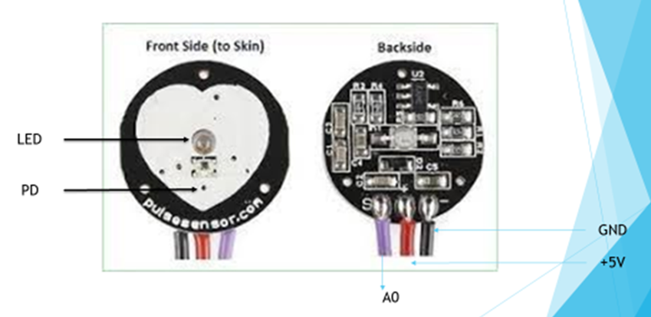
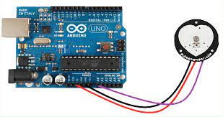
Pulse sensor
The working of the Pulse/Heart beat sensor is very simple. The sensor has two sides, on one side the LED is placed along with an ambient light sensor and on the other side we have some circuitry.
This circuitry is responsible for the amplification and noise cancellation work. The LED on the front side of the sensor is placed over a vein in our human body. This can either be your Finger tip or you ear tips, but it should be placed directly on top of a vein.
Now the LED emits light which will fall on the vein directly. The veins will have blood flow inside them only when the heart is pumping, so if we monitor the flow of blood we can monitor the heart beats as well. If the flow of blood is detected then the ambient light sensor will pick up more light since they will be reflect ted by the blood, this minor change in received light is analysed over time to determine our heart beats.

Slide 14
A algorithm for Measuring BPM:
The algorithm for measuring BPM and IBI is:
1. Initialize Arduino configurations.
-Baud Rate = 9600.
2. Apply input signals to A1.
3. Obtain data from reading A1.
4. Perform Calculations on the data.
5. Print it to the Serial Plotter.
6. Wait 20ms until the next reading.
7. Repeat from step 3.

Slide 15
PROCEDURE:
1. Upload the code to Arduino UNO and Power on the system.
2.The Arduino asks us to place our finger in the sensor and press the switch..
3. Place any finger (except the Thumb) in the sensor clip and push the switch (button). Based on the data from the sensor. Arduino calculates the heart rate and displays the heartbeat in bpm . While the sensor is collecting the data, sit down and relax and do not shake the wire as it might result in a faulty values . After the result is displayed on the serial plotter, if you want to perform another test, just push the rest button on the Arduino and start the procedure once again.

Slide 16
Design flow:
Project design
Hardware design
Arduino uno
Heartbeat sensor
Software design
Arduino IDE

Slide 17
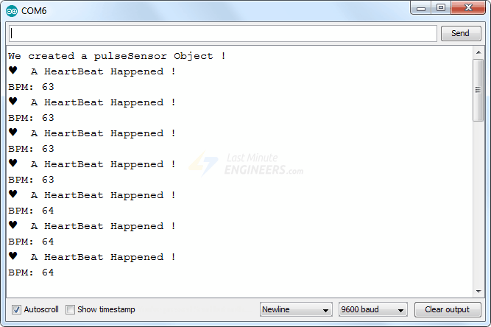
START
DISPLAY ON THE SERIAL PLOTTER
HEART BEAT ANALOG VALUES
ANALOG TO DIGITAL CONVERTION(ADC)
COUNT HEART BEAT
STORE THIS COUNT
ARDUINO
HEART BEAT DISPLAYED ON THE SERIAL PLOTTER

Slide 18
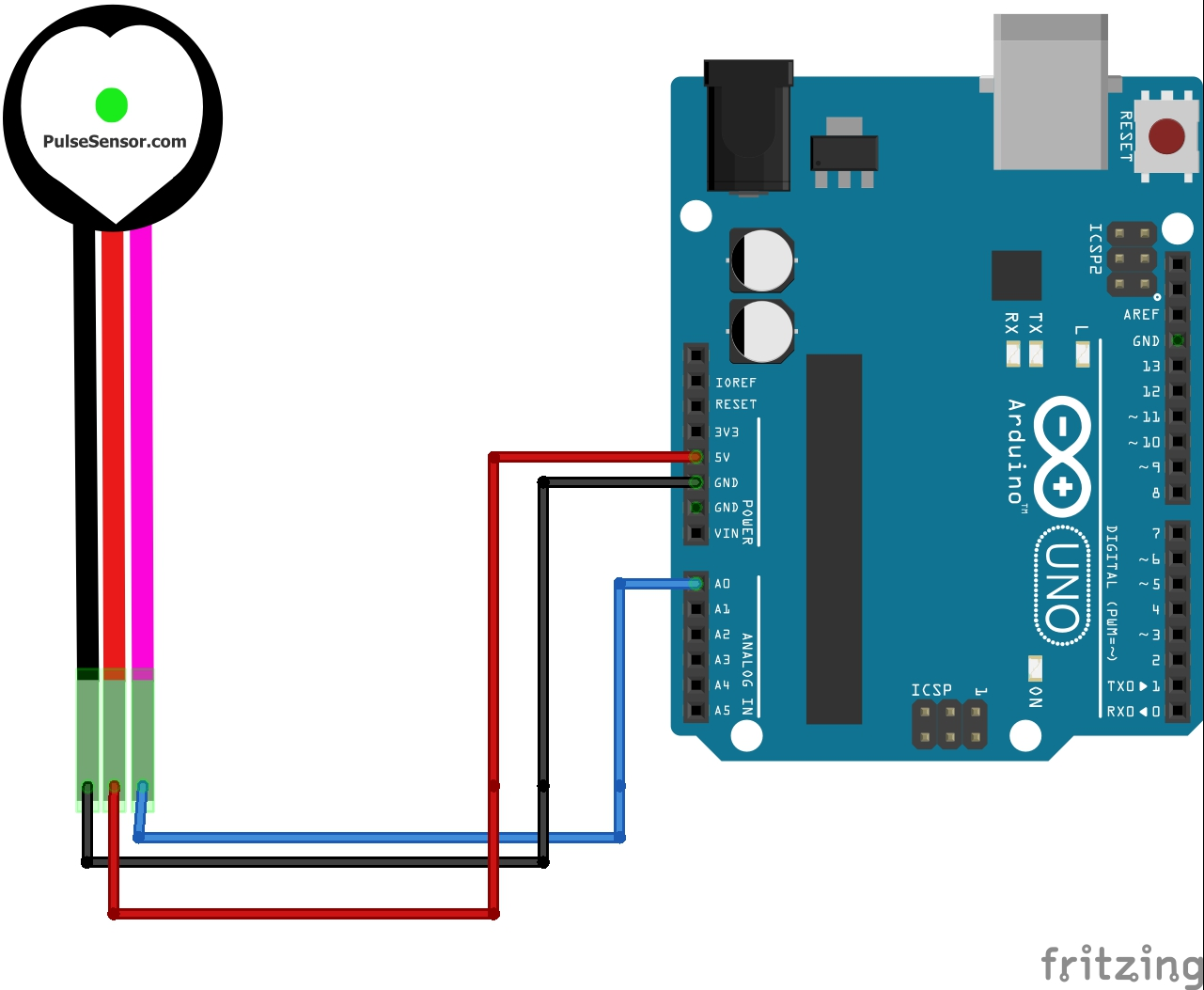
Circuit diagram

Slide 19
Average Heart Rate
Age | Average Heart Rate
Newborn Baby | 140
7 year | 85-90
14 year | 80-85
Adult | 70-80
Athletes | 60-100

Slide 20

Applications of Arduino based health monitoring system
This project can be used as an inexpensive alternative to smart watches and other expensive heart rate monitors.
A set point can help in determining whether a person is healthy or not checking his/her heart beat and comparing with set point
FUTURE SCOPE
1. Design robust system to improve measuring efficiency even in the presence of noise.
2. An IOT based system.
3. Application to send an SMS containing the measured data and the patient’s location to the medical emergency and emergency contacts of the patient in order to get an ambulance and notify his relatives.

Slide 21
Challenges and Limitations:
It may give inconsistent readings which reduces the efficiency of the project.
Logic used is very simple . Therefor , results may vary if a sophisticated instrument is used for the same purpose
pulse sensor might not detect accurate readings if it was placed with excessive or loose pressure on the body.

Slide 22


